Slide 1
Electric Fields

Slide 2
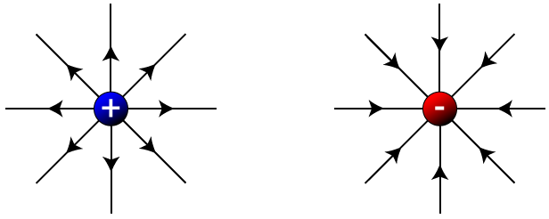
Fields
In physics, a field is a region in which an object may experience a force.
In a gravitational field, objects with mass experience a force.
In a magnetic field, magnetic objects experience a force.
In an electric field, charged objects experience a force.
Electric fields are produced by objects with charge.
Electric fields are represented by field lines with arrows that show the direction of the electrostatic force a positively charged particle will experience at that point.
Notes:
Analogy from gravity: “It helps to think of mass as a property of objects and fields as a property of space. The Earth and the space it occupies are real tangible things. The mass and the field are just properties we measure to help us explain what the tangible things are doing.” – Science Asylum
Charge is a property of particles, just like mass, temperature, or speed.
Note that even if there are no charged objects around, the field is still there – it’s just zero.

Slide 3
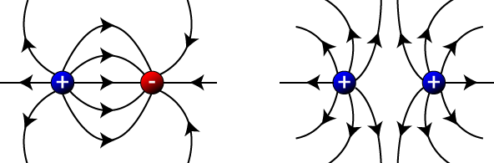
Electric Fields
The density (closeness) of the field lines at any point represents the strength of the field at that point.
Because of this, in diagrams with multiple objects, objects with more charge are drawn with more field lines.
As before, field lines:
Are always drawn perpendicular to the surface of a charged particle or object
Never cross: they show the direction of the net force, not the individual forces from each charged object
Notes:
A lot of the field lines you’ll see in this PowerPoint have non-perpendicular field lines. This is incorrect, but they were the best I could find.

Slide 4
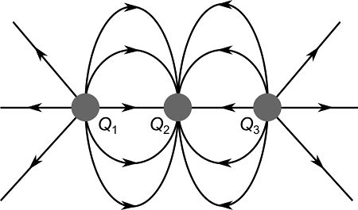
Example #1
The diagram below shows the electric field lines for three point charges separated by a small distance. The outer two charges are identical, but the inner charge is different.
Determine the signs of the three charges.
Determine the ratio between the charges on Q₁ and Q₂.
Notes:
You can investigate three-point charge systems at https://icphysweb.z13.web.core.windows.net/simulation.html

Slide 5
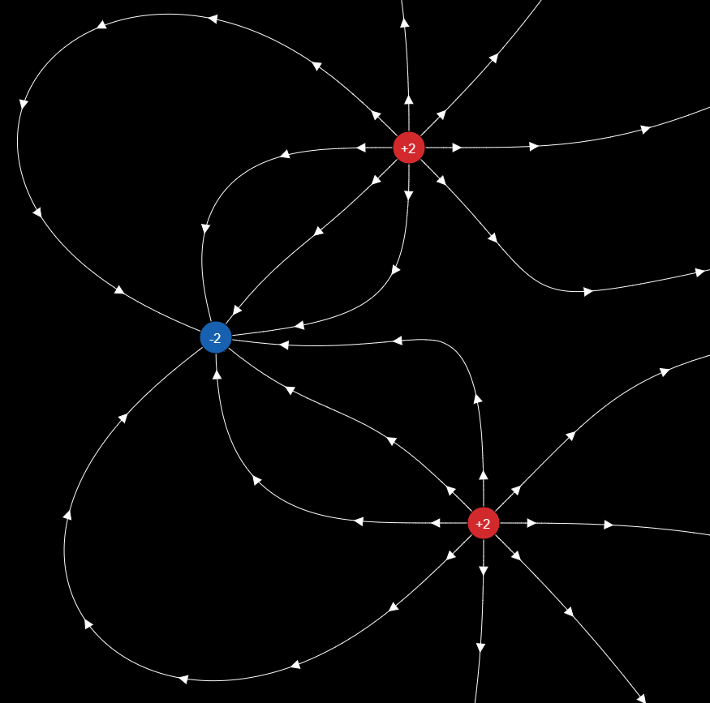
Electric Fields
You may be required to draw:
1, 2, or 3 point charges (both like and unlike)
Point charges are very small charged objects that do not have a distributed mass – we assume the entire charge is located at one point in space. They are good models for protons and electrons.
Point charges are represented by circles.
Parallel charged plates
Parallel charged plates and a point charge

Slide 6
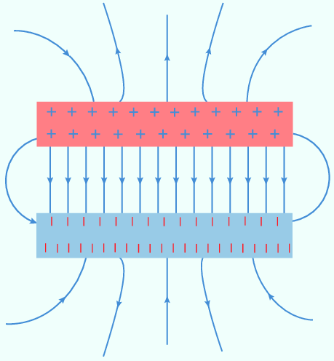
Electric Fields
You may be required to draw:
Parallel charged plates, with or without a point charge between them
+ + + + + + + + + + + + + + + + + + + + + + + + +
+
- - - - - - - - - - - - - - - - - - - - - - - - - - - - - - - - - -

Slide 7
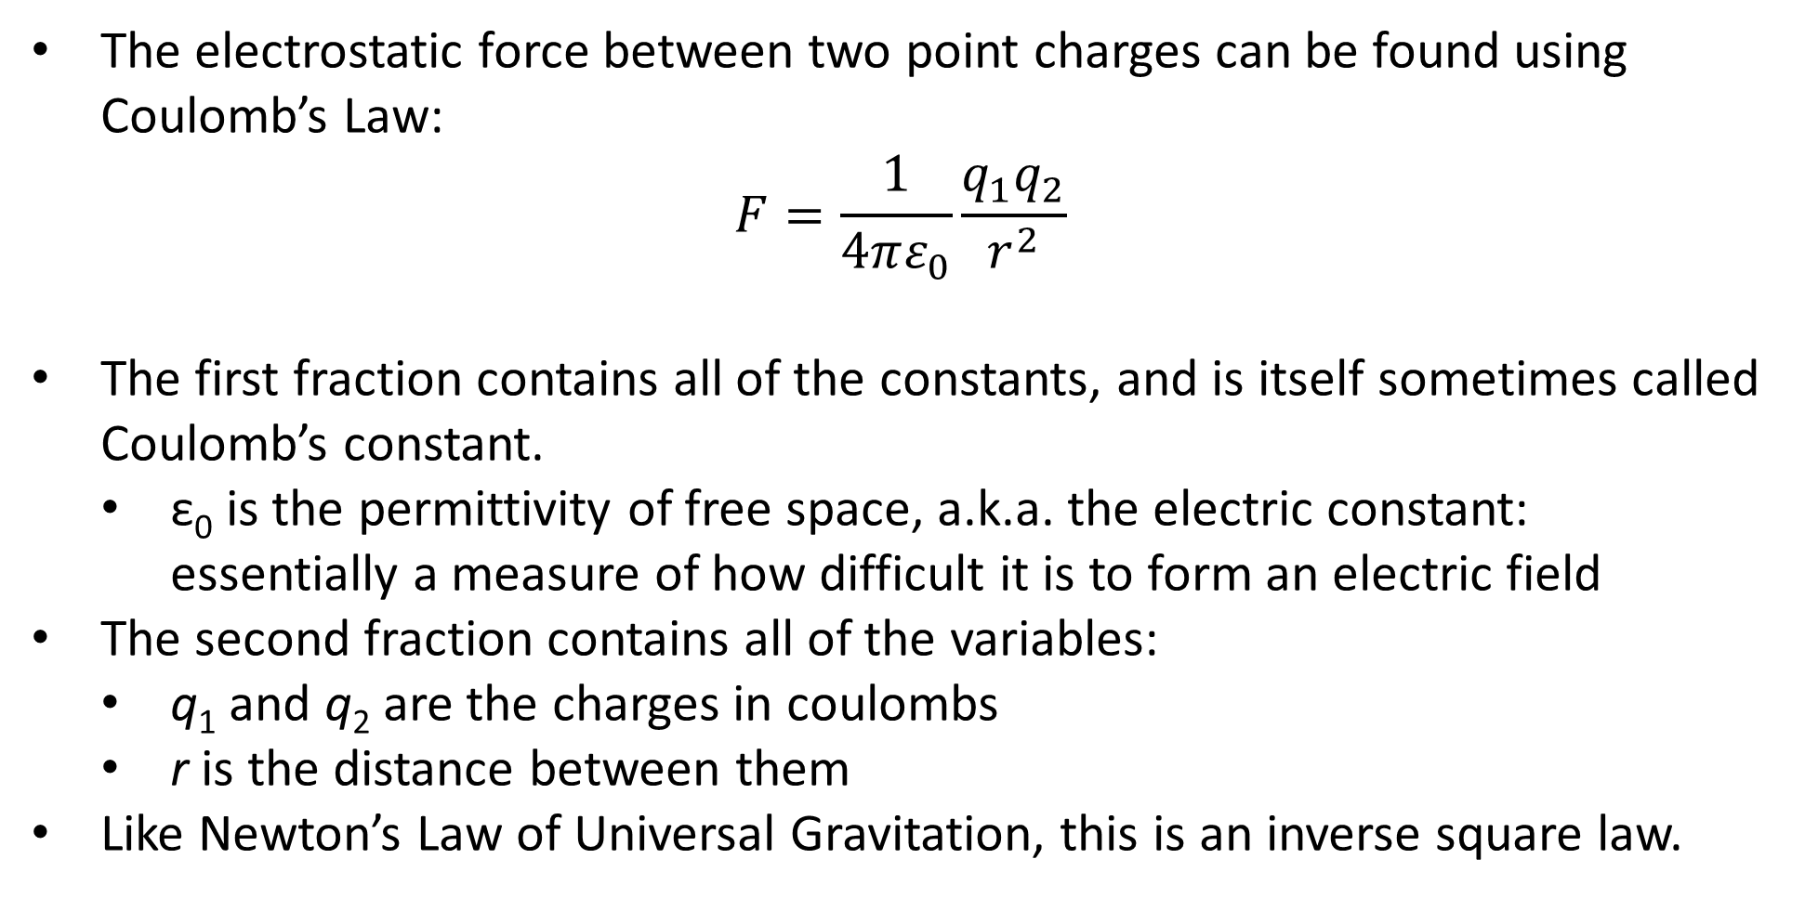
Coulomb’s Law
The electrostatic force between two point charges can be found using Coulomb’s Law:
$$F=\frac{1}{4πε_{0}}\frac{q_{1}q_{2}}{r^{2}}$$
The first fraction contains all of the constants, and is itself sometimes called Coulomb’s constant.
ε₀ is the permittivity of free space, a.k.a. the electric constant: essentially a measure of how difficult it is to form an electric field
The second fraction contains all of the variables:
q₁ and q₂ are the charges in coulombs
r is the distance between them
Like Newton’s Law of Universal Gravitation, this is an inverse square law.
Notes:
Don’t get confused by the ‘free space’ thing – Coulomb’s Law still works outside of a vacuum (though the net force may change for other reasons).

Slide 8
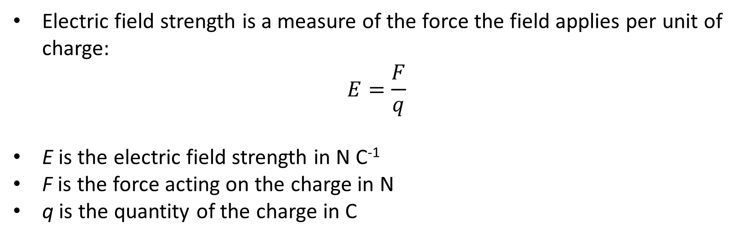
Electric Field Strength
Electric field strength is a measure of the force the field applies per unit of charge:
$$E=\frac{F}{q}$$
E is the electric field strength in N C⁻¹
F is the force acting on the charge in N
q is the quantity of the charge in C

Slide 9
Example #2
What force is applied to a 1.00 mC point charge located 2.00 cm from a 20.0 mC point charge?
Calculate the electric field strength from each of the charges (without considering the other charge).
Notes:
4.49 × 10⁸ N
4.49 × 10¹¹ N C⁻¹
2.25 × 10¹⁰ N C⁻¹

